Slide 1
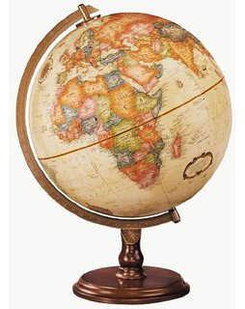
Hello!
Just do as you always do ☺

Slide 2
Let’s look at the E in EIO

Slide 3
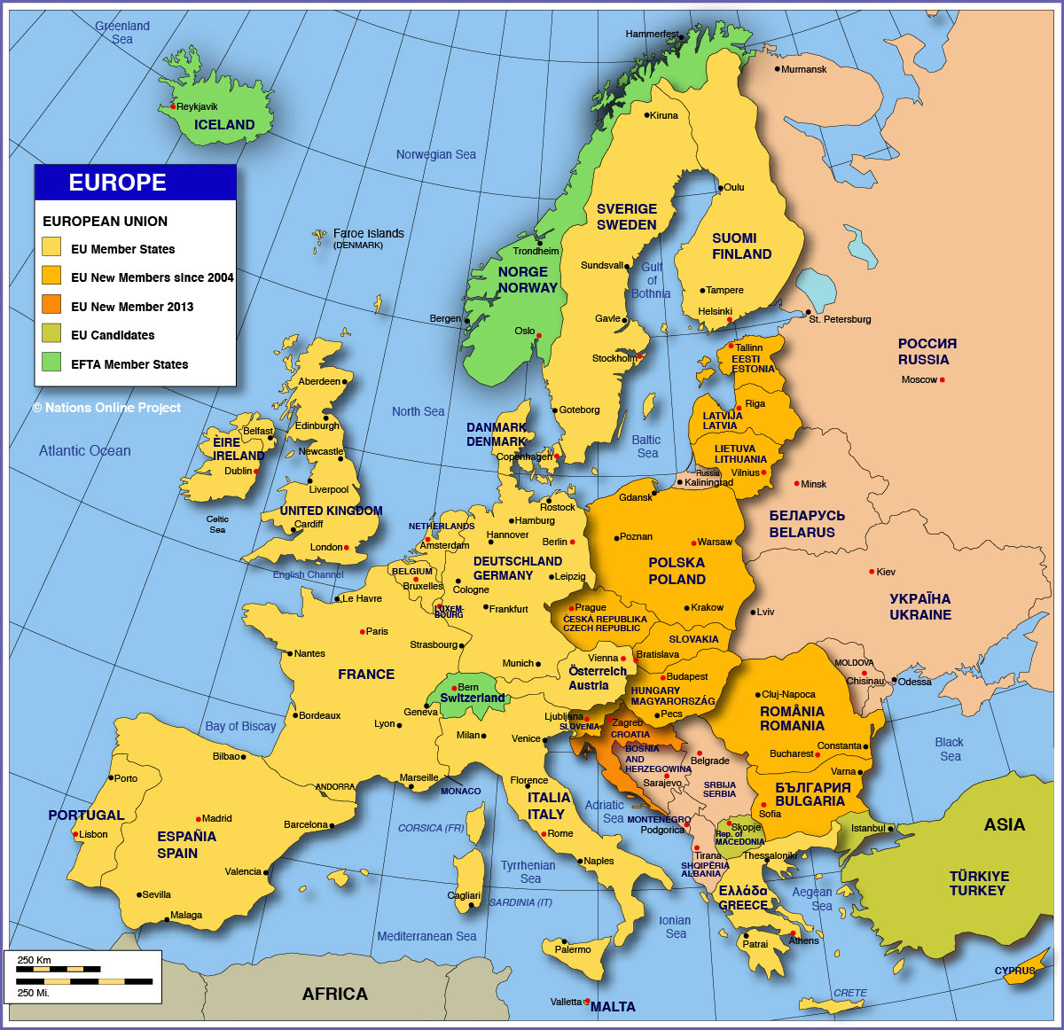

Slide 4
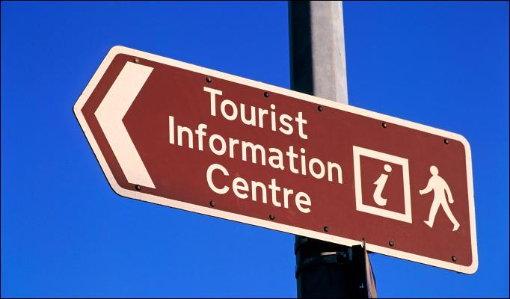
Let’s play Tourist Information Centre
Choose a EU-member country
One that you haven’t visited
Create a poster that attracts tourists to that country
You can draw/write/print anything you like, but…
Don’t add the name of the country

